Slide 1
Massachusetts Water Resources Authority
Update for September 2023 LCR Sampling
September 6, 2023

Slide 2
Introductions and Training Logistics
Everyone is muted – please use raise hand or chat function, or just unmute and ask your question.
Put your name, affiliation and email address in the chat to ensure TCHs are received.
There will be some content questions – answer using the chat function.
There will be a survey link and QR code at end – please fill it in

Slide 3
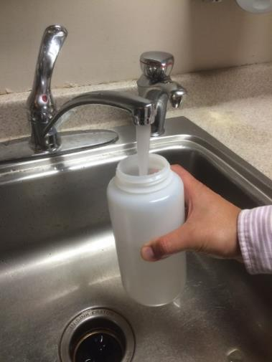
Sampling will begin this week
Bottles are ready at Chelsea and Southboro labs
Residential sampling can begin now – all in before end of October
School sampling should occur once school has been in session for a few days or longer – sample schools Tuesday to Saturday
Deliver samples within a week
  Can make multiple deliveries
Questions:
  Call Beverly Anderson
  857-270-1027

Slide 4
Few key issues we wanted to remind you of
Importance of verified, DEP-approved sampling plans
New 24-hour Public notice requirement if over Action Level (AL)
3-day notification requirement for any individual sample over AL
“Find and Fix” requirements for any sample over AL
Upcoming forum on changes to LCR and deadlines in in 2024.
  September 26 -- 9am to noon – in-person with remote option
Current water quality conditions update (while we have you)

Slide 5
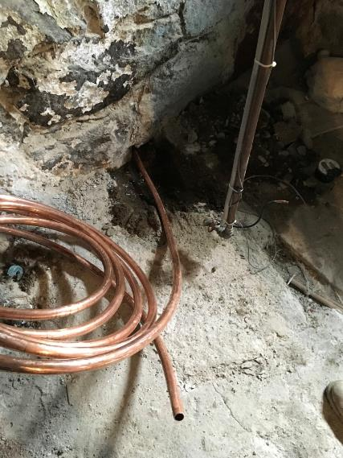
Importance of Verified Sampling Plans
If you have Lead Service Lines (LSL), priority is to sample those homes
If your plan says a site is a LSL, verify that it is!
EPA audits have found sampling plans with inaccurate site designations
  Sites identified as LSL, but
    Never were lead, or have been replaced
    Mis-identification resulted violations
Use an alternate site of same tier
  (unless original had result over AL )

Slide 6
24-Hour Public Notice
EPA is imposing this new requirement in advance of the LCR Revisions
If a community 90th percentile is over the Action Level:
  24-hour public notice using newspaper and other media
  New template for notice – focus is on LSL
Recommend discussing with town officials and preparing in advance
Timing trigger is completion of all lab results, but could still be a surprise
MWRA available to assist with notice and follow up activities
  Still need to do mailed public education brochure (also new)
WATER DEPARTMENT DRINKING WATER NOTICE:
Some homes have high levels of lead
This notice contains important information about your drinking water. Have someone translate it for you or speak with someone who understands it.

Slide 7
3-Day notice for any sample over the Action Level
EPA is imposing this new requirement in advance of the LCR Revisions
MWRA will immediately email and call for any result over the AL
  Will provide letter template and reminder
Town must let sampler know with three days – call and mail
  Let them know you will do an investigation
Keep records of all actions with dates and copies
  Another area of problems in EPA audits

Slide 8
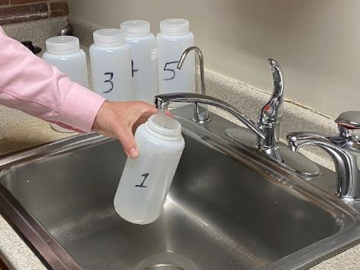
“Find and Fix” requirements for any sample over Action Level
EPA is imposing this new requirement in advance of the LCR Revisions
Follow-up within 30 days
  (You will already have provided data within three days)
  Offer to investigate causes
  Offer investigatory sampling (can be anything useful)
  Consider removing LSL
Keep good records of all actions and results
  Including all phone calls
MWRA will also do some system sampling

Slide 9
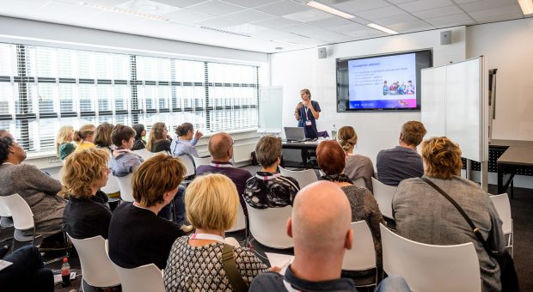
Upcoming forum on LCR changes and deadlines
Several major deliverables due October 16, 2024
Lots of new requirements in place after October 2024
Lead and Copper Rule Changes Forum:
  September 26th 9 am to noon
  MWRA Chelsea office
  Remote option
  TCHs offered
Registration info available soon

Slide 10
Please answer these questions in the chat and take the survey at the link or QR code
What happens if a water system’s 90th percentile is over the lead Action Level of 15 ppb?
  They must issue a public notice with 24 hours
  They must distribute a public education brochure to all customers
  Include lead information in next years CCR
  All of the above
2. Which requirement is new? a, b or c?

Slide 11
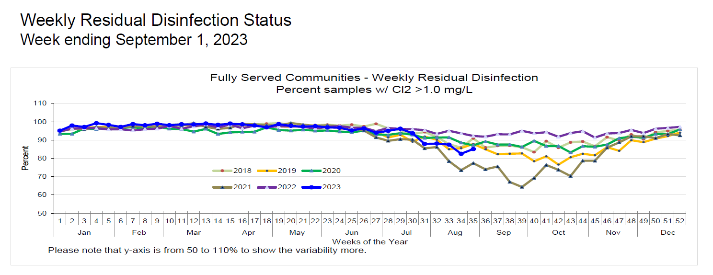
Community Trends
Distribution
  Another wet summer! Similar to 2021
    Quabbin transfer
  Chlorine decay through community distribution systems
    Some lower Cl2 and increased TC+
  Worked with disinfection committee – tried to stay ahead of the curve
    Changed Cl2:NH3 ratio
Notes:
Come July – the impact on system wide residuals was underway.

Slide 12
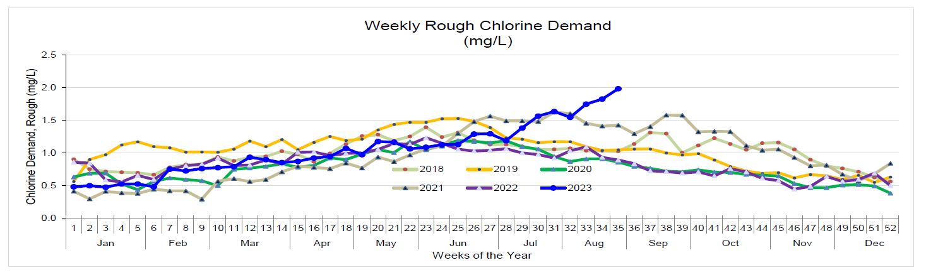
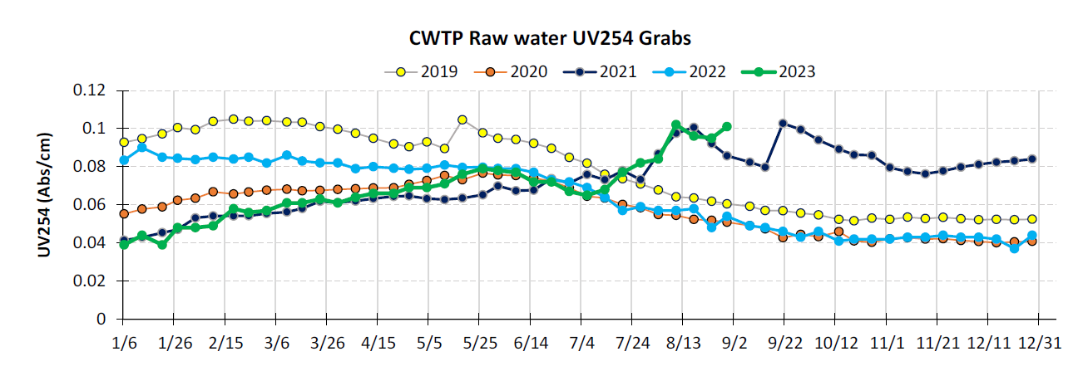
Where are we now – UV254 and Chlorine Demand
Cl2 demand – higher than 2021 – dosing at 4.7 mg/L
  Aim for 2.2-2.5 mg/L at 9A
Elevated UV254 – similar to 2021 – could lead to higher Pb levels
Notes:
We are starting off this season with even higher UV254 than last year! And limitations (due to projects) may hamper our ability to transfer Q water.

Slide 13

Questions or Comments?
Stephen Estes-Smargiassi
smargias@mwra.com
617-788-4303 (o) 617-839-9638 (m)
Beverly Anderson
Beverly.Anderson@mwra.com
617-788-4822(o) 857-270-1027 (m)
Josh Das
Joshua.Das@mwra.com
508-424-3679 (o) 857-270-1413 (m)
Drink with Confidence
Flush with Pride
This presentation represents the opinions of the author and not necessarily those of the MWRA
13
Notes:
13

Slide 14
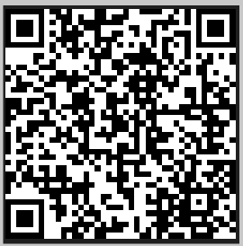
To qualify for TCHs --
Please fill out the survey at this link or scan the QR code below:
https://www.surveymonkey.com/r/PB8DMXC

